Slide 1


Train the Trainer:
Scenario Exercising
Building resilience together
vcsep.org.uk

Slide 2

Purpose and Objectives
Purpose of Train the Trainer:
Equip participants with the confidence to run a tabletop exercise with their own community, team, organisation or network
Learning Objectives:
Understand approaches to exercising that include those less typically engaged in resilience building
Learn to facilitate a scenario-based exercise to enhance readiness for emergencies
Preparation towards designing an exercise plan
Notes:
This training is designed to give you all the tools you need to confidently run your own emergency preparedness or response exercise, either in-house or with your networks.
It will focus on the essentials of running an exercise, the planning, preparation, scenario design and debrief.
Attendees should leave with the ability to design, coordinate and facilitate your own scenario exercise.
So if you’re brand new to exercising – think about how you might bring your own risk assessments to life through exercising
IF you’re very familiar with a particular way of exercising, think about how you can exercise differently, with different people to strengthen understanding
Benefits of exercising – Learning, stress testing, collaboration, identify gaps, understand capabilities

Slide 3
Quick intros
- Name
- Organisation
- Experience of exercising
/ or / how you’re hoping to use exercising

Slide 4

The Resilience Gap
Frequency of emergencies
Needs in emergencies
The ‘resilience gap’
Traditional response capacity
Whole of society resilience
Traditional response
Notes:
As organisations, a partnership, and a society we are facing more frequent and compounding risks and emergencies, with the importance of personal resilience growing. As the number of emergencies goes up, the capacity of traditional response – Cat 1, Cat 2 responders, the Local Resilience Forums around them – is stretched, creating a resilience gap.
What we mean by the resilience gap is that as more people are impacted by systemic and traditional emergencies, resources are stretched, there is a gap in who can be helped, or help themselves
Exercising is a known way of strengthening resilience - by testing our preparedness, our responses, or business continuity plans, for how we would respond, and be more resilient, should an emergency impact us.
We can proactively prepare, identify gaps and build capacity and capability by investing time and thought now.

Slide 5
Types of exercising
In person live simulations (involve role play and actors) – hugely resourced, months of planning, involve multiple stakeholders
Tabletop exercise – Talk through actions rather than physically do them, in person or online – size and scale varies but tend to test an evolving incident
Micro Exercises – Are much smaller, focus on a singular aspect
These tend to focus on how to respond to a particular event – flood, fire, cyber attack, power outage etc and look at protocols and step processes
Our focus is more risk agnostic and aims to consider information flow, how you partner with others, the wider VCS, community preparedness etc

Slide 6
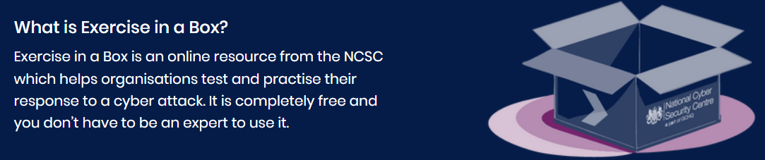
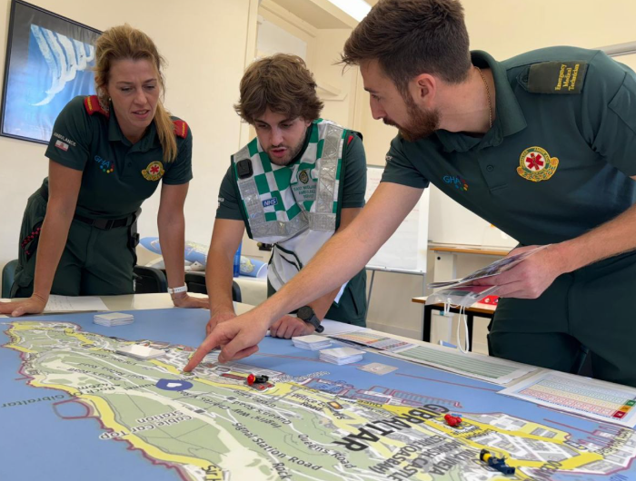
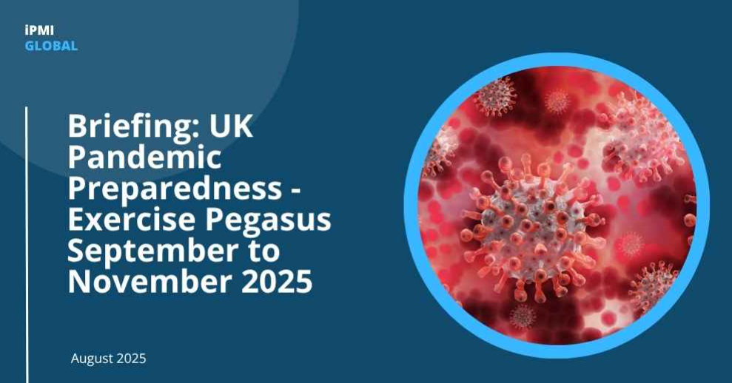
Exercising as a sector
Notes:
We know exercising happens, both locally and nationally, there are tools like ‘Exercise in a box’, National Exercises like the very recent Ex. Pegasus which wrapped up earlier this month. The resources we’ve developed are another way, not the way. Emergency response work is owned and held by Local Resilience Forums around the country, so whatever we do to practice and exercise outside that must acknowledge and tap into those formal structures.
The resources shared are designed to be used by anyone across the partnership and raise awareness of exercising beyond those formal structures, to widen the network of organisations thinking about what they would do should something awful happen.
Whilst we are providing a resource, we are encouraging it to be tailored, used flexibly, and promote the principles behind it – to consider how you exercise, where there might be a different approach to explore from a different context, rights based over risk based, looking at the range of people or groups involved, and the different challenges faced in emergencies.

Slide 7
What makes a good exercise?
Things we’ll consider today
Identifying objectives – what are you wanting to test?
Audience – who is involved, is anyone missing?
Scenario – relevant to the audience and organisation
Injects – Move the discussion along, stress test
Roles – facilitator, notetaker, observer
Debrief – what happens next, capturing actions
Trainer Role
Ensure clarity in objectives, align exercise with participants' roles

Slide 8
Four ways… and more?
We’ve identified four ways you might consider using these resources... There may be more:
1. With internal teams
Looking at the scenario (and injects) from the perspective of your team’s ways of working. How would they be impacted in this scenario
2. Across a geographic microcosm
Different organisations across a community/region/geography (for example LRFs, VCS orgs, Local Authority, community groups) to look at the scenario from a hyper-local point of view
3. To strengthen relationships
Whether LRF and VCS or a group of response organisations (for example BRC, RE:Act, FANY) to increase understanding of capabilities and ways of working
4. To onward train
Run a train-the-trainer session like this one (for example with volunteer managers) who can then re-deliver to the groups they work with, and stress test their ways of working.
Notes:
We as an EP Team regularly practice Internal exercising (EP Team – once a quarter) – thinking about what are actions and activity would be in the event of different emergencies. We’ve also seen collaborative exercising (British Red Cross, RE:Act, First Aid Nursing Yeomanry) and Geographic Exercising (GMCA, BRC, Islamic Relief, Didsbury Mosque and many more) coming together to test their responses, understand each other better, build the knowledge of capabilities, review response plans and how they’d work alongside each other in a safe environment.

Slide 9
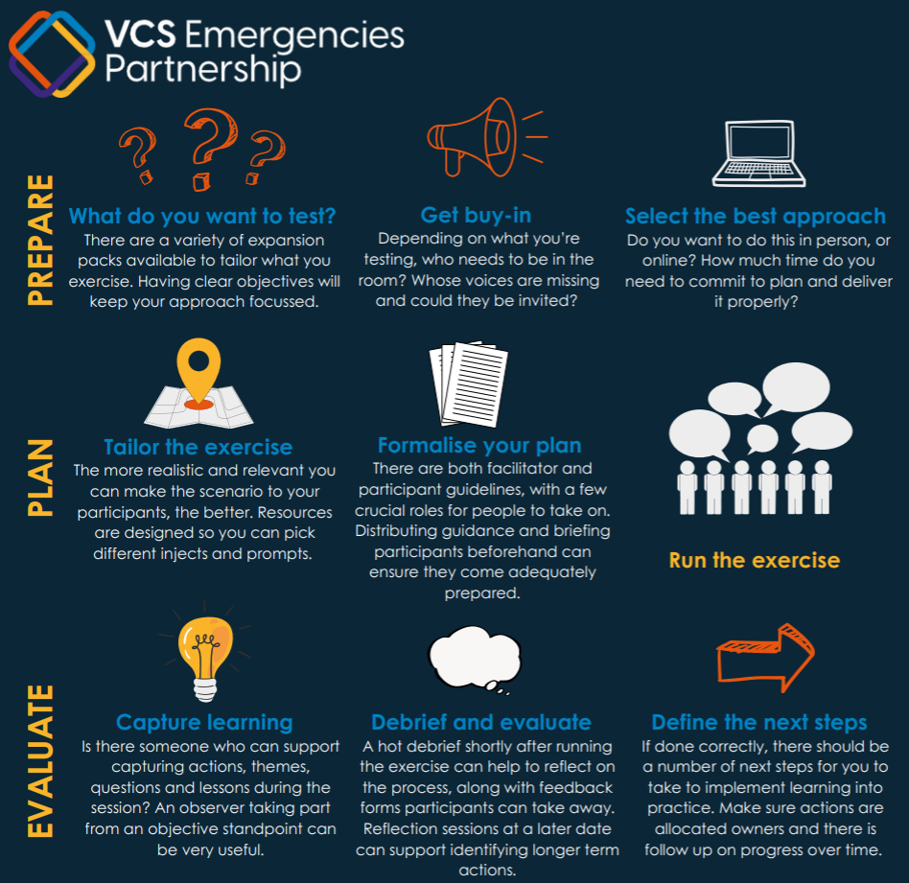

Self-assess what you might improve on. Do you have existing plans to test? Are you new to exercising? Do you only exercise in a particular way? How might that be limiting?
Are you testing internal processes?
What are the benefits/drawbacks of only looking internally?
Can you invite sector partners to a joint exercise? How do you create the conditions for that?
Be prepared to find gaps you might not know how to fill. How do you reflect that back and decide what changes are actionable?
There might be a scale of change.
Notes:
Plan:
Is it a specific incident or a way of responding you want to test?
What typical impacts of an emergency do you want to test?
Who is best suited to the different roles? (more on this later)
What are the necessary lead times to do it properly?

Slide 10



PREPARE
Objectives
What are your objectives?
What are you ideally trying to achieve?
Purpose
What is the purpose of conducting the exercise?
Who would need to be involved?
What are the boundaries?
Scope
Whose voice would bring varied perspective?
What is the best forum for your time and capacity?
Notes:
What are your objectives? What are you ideally trying to achieve from an exercise?
What is the purpose of conducting it?
What is the scope? Who needs to be involved, what are the boundaries?
Who needs to be behind it?
Whose voice would bring varying perspective?
What is the best forum for your time and capacity?

Slide 11



PLAN
Objectives
Is it a specific incident or a way of responding you want to test?
Purpose
What impacts of an emergency do you want to test?
Who is best suited to the different roles?
Scope
What are the necessary lead times to do it properly?

Slide 12



EVALUATE
Objectives
Reflect on successes, challenges and areas for improvement
Purpose
What actions will you take as a result?
What will be incorporated into future plans? How?
Scope
How do you communicate the timelines for actions?

Slide 13
Roles in exercising
Planning Team/Lead Planner
Most crucial role, needs senior backing and wider input to define and shape the exercising
Facilitator
Ability to inform but not lead the conversation, course correct, mediate/mitigate and keep to time
Notetaker
Ability to capture learning, themes, outcomes and actions. More than just minutes, to summarise and play back what they’ve heard
Participants
The participants should be prepped in advance about the purpose and aims of the exercise but not the scenario itself. Important that participants ‘don’t fight’ the exercise and ‘work with’ the opportunity, to gain the most benefit
Observer
Can be same person as notetaker, but beneficial as an impartial observer to give feedback on what they see

Slide 14
Planning Team / Lead Planner
At present – this is you! Who else might you need to engage or draw support from? CEO? Team Lead?
Think of yourselves as the project manager, your role is to assemble the team you need to deliver an exercise and draft out the timelines to do it.
The Lead Planner will also need to draft or tailor the scenario and injects
What should a scenario contain?
The initial scenario should introduce a plausible, detailed story or sequence of events designed to test what you want to test. Sometimes simplicity is key, you don’t have to throw the kitchen sink at it
What is an inject?
Injects are pieces of information that shift or progress the scenario. It can come in the form of new or emerging information

Slide 15
Facilitator/ Notetaker
Facilitator – Core Skills
Communication, adaptability, active listening and time management
Able to keep discussions on track, encourage participation, manage group dynamics
Notetaker – Core Skills
Active listening, playback, consolidation of themes, identify actions
Able to reflect what they’ve observed, capture actions and articulate success and challenges
Do facilitators and notetakers participate?
Generally, no, a facilitator might interject or insert a pause to get discussion back on track but they’re not active in the exercise.

Slide 16
Participants
Preparation
This should be as realistic as possible, so participants shouldn’t receive too many details about the scenario exercise in advance, but, there should be clear communication on the aims and objectives in advance as well as the time commitment from them.
In Exercise
They should know this is a safe space for learning, not a test of them or the ways of working. Whilst it aims to be realistic, there may be a need for them to ‘get on board’ and work with the exercise, not against it.
What is the ideal number of participants?
There is no magic number but enough to comfortably manage and allow everyone to participate

Slide 17
Debriefing
Enough time for debriefing is as important as having enough time to exercise. There are a variety of ways to capture participant thoughts and some immediate reflections will be helpful, but longer-term considerations may come through with a bit more space and time.
Debrief Structure
What went well: Capture successes
Challenges: Discuss issues encountered
Action Items: Identify follow-up actions to improve plans

Slide 18
How might you run a debriefing?

Slide 19
The resources
Facilitation guidelines
An infographic and guidelines, facilitation tips and example exercise structure
1 x general scenario
The focus of which is on mass migration, a diverse group of people arriving to your area with unknown needs
Prompt questions
There are four prompt questions to stimulate thinking. They are base level questions you can return to
7 x expansion packs
The expansion packs are themed by different aspects of response you might want to stress test
3 x injects
Each expansion pack has three different injects which develop the scenario along a timeline
Prompt questions
Each inject has three or four further prompt questions to help stimulate thinking

Slide 20
Exercise injects
There are seven expansion packs, each with three injects and prompt questions.
We recommend you pick a maximum of three injects to exercise with.
1. LRF and VCS connections
2. Equality
3. Volunteer management
4. Recovery
5. Existing emergency plans
6. Person-centred approaches
7. Mental health

Slide 21
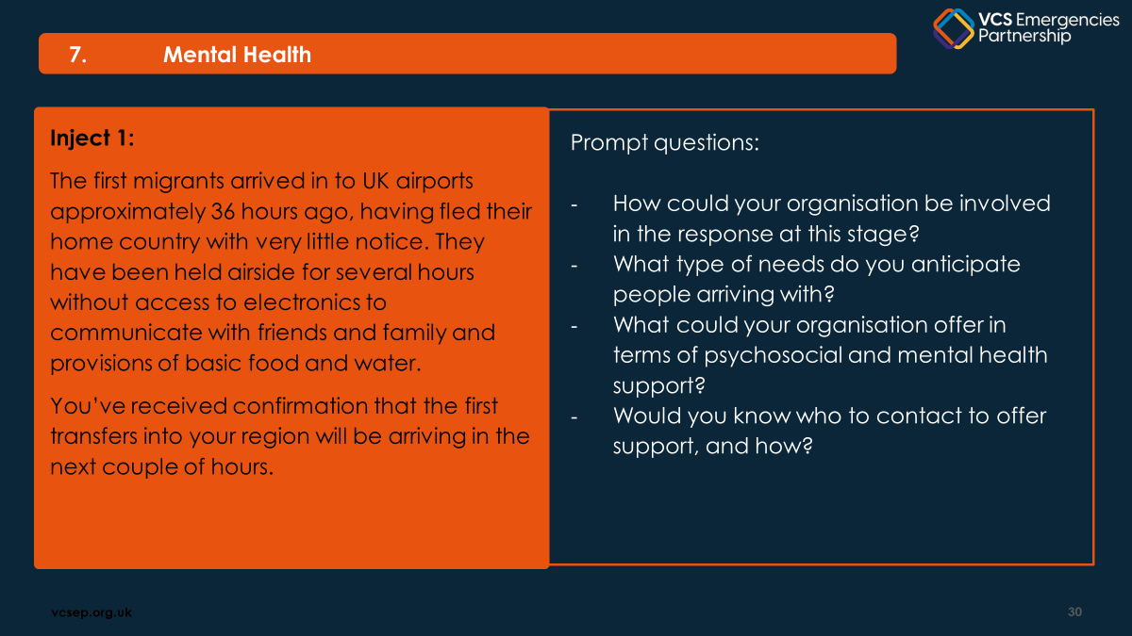
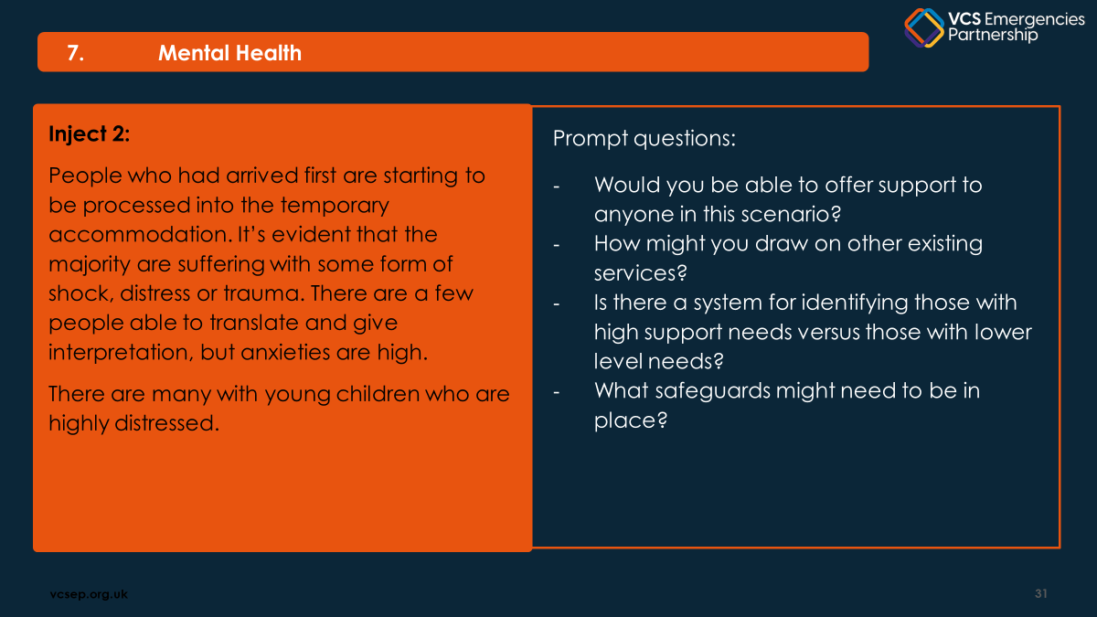
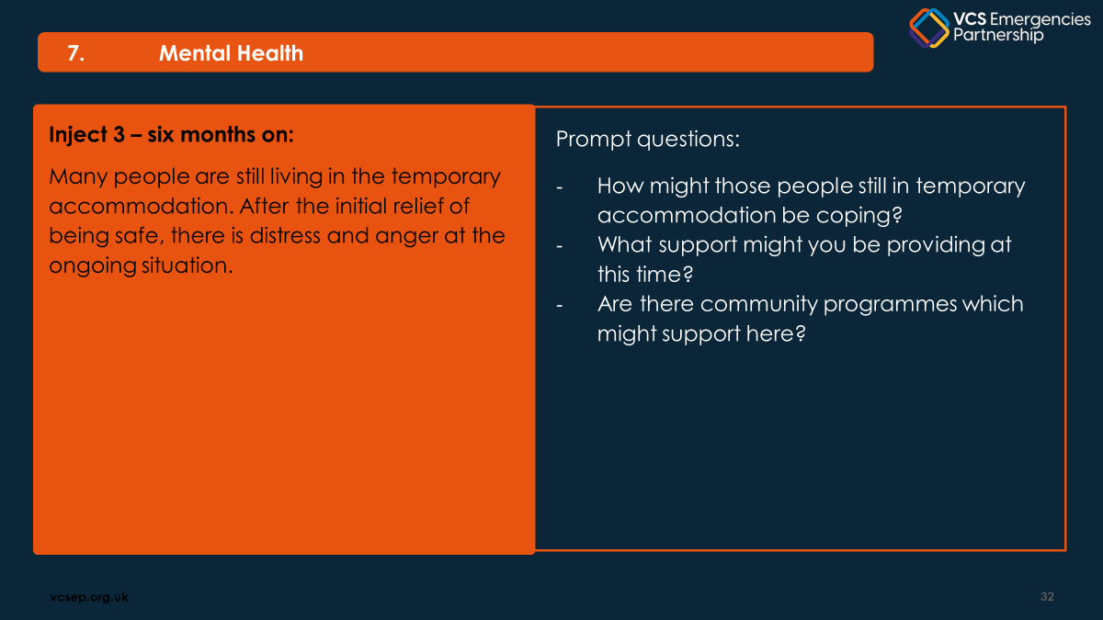

Slide 22
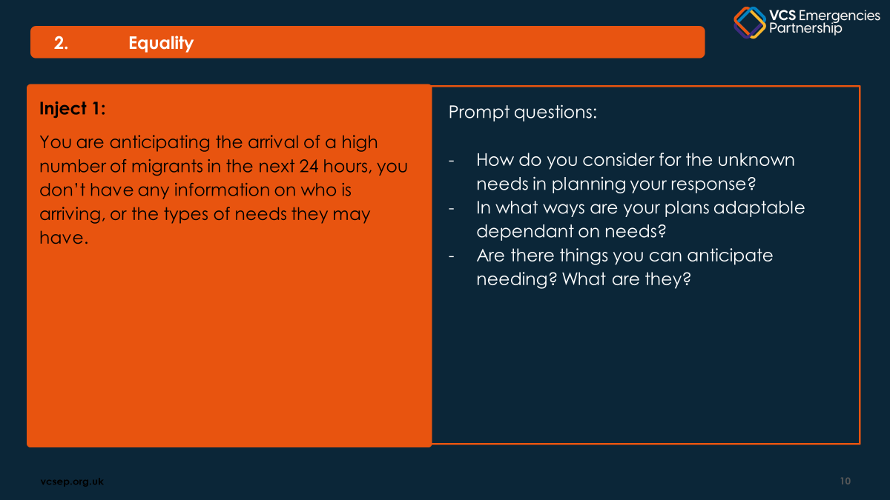
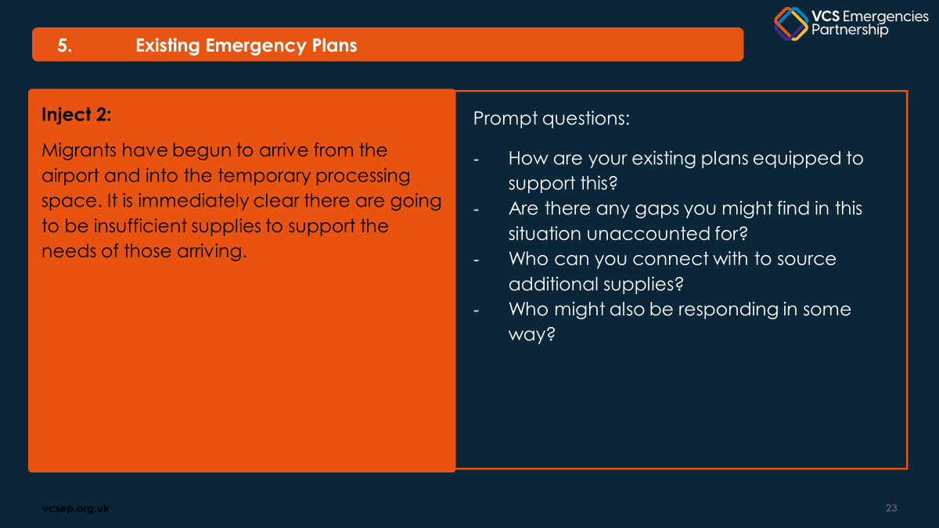
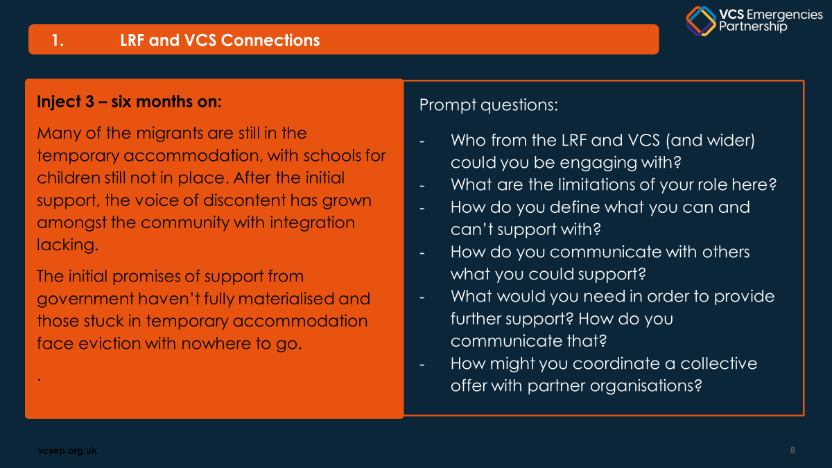

Slide 23
Design your own
Think about what you want to test?
What are the aims and objectives?
Get creative – or use AI
“Hi ChatGPT, I need help to write a brief scenario exercise with maximum two injects that I can use with my volunteers who aren’t emergency responders but have stepped up to support an unfolding emergency - I want the scenario to be based on communications in emergencies and to maybe reflect some of the challenges of the recent Spanish/Portuguese power outage as if that happened in the UK. Can you please help?”
Note of caution
Using AI is a great way to help design an exercise but be mindful of both its environmental impact and security issues if inputting sensitive information or data to build your scenario

Slide 24
Make it relevant, keep it simple
Simple scenario:
On a weekday morning, a major power outage hits large parts of the UK, affecting the Midlands, South West England, and parts of the South East. Grid failures ripple across regional power connections and mobile networks become unstable. Within the first hour, there are reports of several sectors (healthcare, transport, local councils, voluntary organisations) facing communication issues and service disruptions.
The Team are made aware by local news reporting and social media.
One inject:
30 minutes into the incident
Several partner agencies report that their internal communication systems (email, shared drives, cloud-based systems) are down. Mobile coverage is patchy. A regional NHS England states many trusts are switching to emergency protocols but can’t confirm which sites are operational. Local authorities are asking for situational updates and priorities.

Slide 25
Breakout: Mini scenario design
15 minutes to design a group exercise:

Slide 26
Breakout questions:
1. Exercise Goal (Why are you running this?)
(Test response to a cyber incident, raise awareness of a comms breakdown, team responsibilities)
2. Audience (Who is this for?)
(Senior leadership, frontline staff, volunteers, community members)
3. Scenario Hook (What happens?)
“On Monday morning, you learn that your systems are down due to a ransomware attack…”
4. Prompt Questions (To help discussion)
“Who do you notify?”, “What’s your first action?”, “What decisions need to be made?”
5. Debrief Prompt (To close it out)
“What worked well?”, “What would you do differently?”, “What gaps were exposed?”

Slide 27
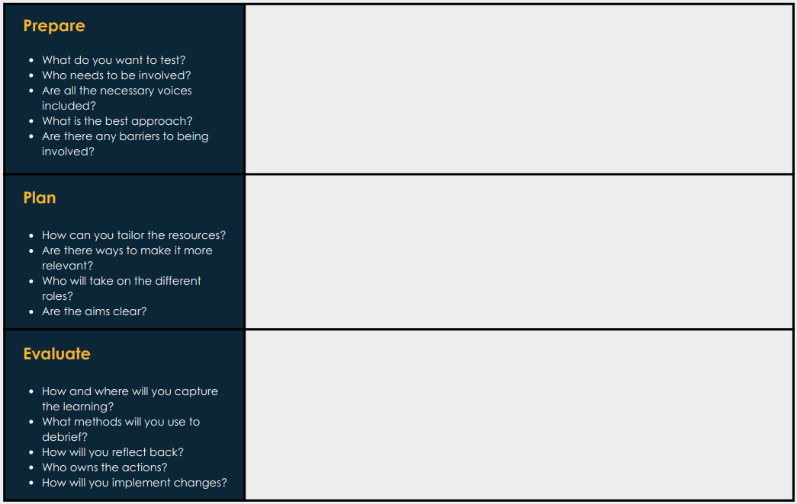

Slide 28
3 Key Takeaways:
1. Make it relevant, tailor to your audience
2. Get a buddy and planning team to support buy-in
3. Make sure the exercise goes somewhere with follow up actions

