Slide 1

Communities Resilience Capabilities Project: Information Session

Slide 2



About the programme
Project Purpose and Audience​
  Empowers charities, community and faith groups to support local emergency preparedness.
  Build long-term, meaningful capability to prepare for and respond to emergencies
  Remove barriers and provide tailored support
Project Objectives
  Community-led preparedness and response planning
  Interpreting risk in local contexts
  Facilitating local exercises and training
  Strengthening relationships
  Promoting inclusive resilience
  Adaptability
Notes:
This initiative helps organisations like yours and your partners build long-term, meaningful capability to prepare for and respond to emergencies. We know most charities, community and faith groups aren’t emergency specialists, and that’s okay.
This programme is here to remove barriers and provide tailored support so you can engage confidently in resilience work. By joining, you’ll help shape how capability is built in ways that are relevant, inclusive, sustainable, and rooted in community ownership.
Community-led preparedness and response planning
Interpreting risk in local contexts: Identifying strengths, vulnerabilities, and co-creating practical solutions to build sustained resilience
Facilitating local exercises and training
Strengthening relationships: Building connections between community organisations, locally and regionally
Promoting inclusive resilience: Understanding disproportionate impacts and ensuring equity
Adaptability: Reusing and tailoring resources for future risks

Slide 3
Programme Overview – the offer
In-Person Train-the-trainer workshop – 2nd March 2026, Aldgate
  A full-day training combines facilitation with scenario-based learning to build practical resilience skills.​
Resources
  Reusable templates for you to adapt for your local communities
Funding
  £1,500 fund to carry out the programme requirements
Notes:
VCSEP and British RedCross are supporting us with this project
The morning training focuses on three areas:
i) the stages of planning, preparation, scenario design and how to debrief well
ii) the roles required to support delivery,
iii) practical resources.
Attendees will gain the skills to design, coordinate and run your own scenario exercises, either internally or with your network.
The afternoon will provide opportunity to take part in a table-top exercise
In person workshop to meet like minded organizations, network and support each other … there will be lunch
As part of the Train-the-Trainer workshop, your organisation will receive ready-to-use templates focused on specific risks created by British Red Cross. These will be based on the two to three most common topics identified from participant applications.
During the training, you will also learn how to assess local risks and adapt these templates, so the exercises reflect your community’s unique needs, priorities, and realities. You don’t need to use the templates although they are there to support your delivery.
Delivering your exercise will involve customising the templates for your context, inviting relevant partners, including organisations representing disproportionately impacted groups, securing an appropriate venue, and managing all aspects of delivery on the day. We encourage collaboration with local partners.

Slide 4
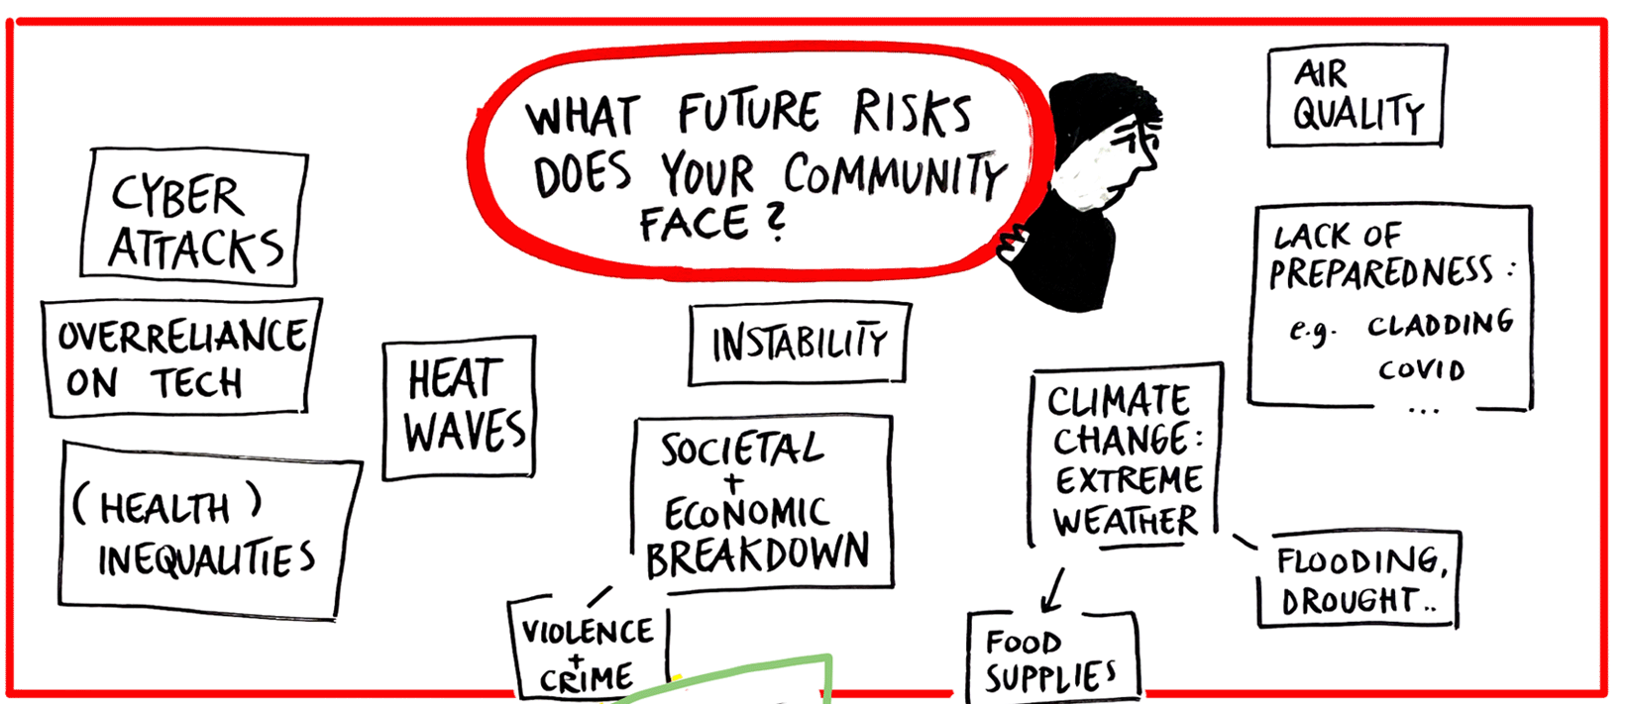
Programme Overview – the requirements
Deliver a community exercise
Deliver a follow up activity of your choice
Complete and encourage your participants to complete feedback surveys created by LCEP
Notes:
1 x community exercise, in person delivery, expect around 10 participants per exercise (can be more), encourage the involvement of equalities partners. tailored for your communities needs e.g. might slightly change the wording etc.
Follow-Up Activity
In addition to delivering the table-top exercise, your organisation will be required to provide a follow-up activity that meets one or more of the project’s objectives mentioned in the first slide.
This follow-up could take various forms, such as:
Enhancing your existing programmes in this space
Extending the event on the day to support relationship building
Hosting an additional session based on learning from the exercise
Complete survey
To deepen multi-agency understanding of how to meaningfully engage community groups in emergency preparedness, LCEP will host a dedicated online learning event and produce a report capturing insights, learning, and experiences from participating partners – therefore the collecting of feedback part of this project is important so that we can continue to improve the wider system.

Slide 5
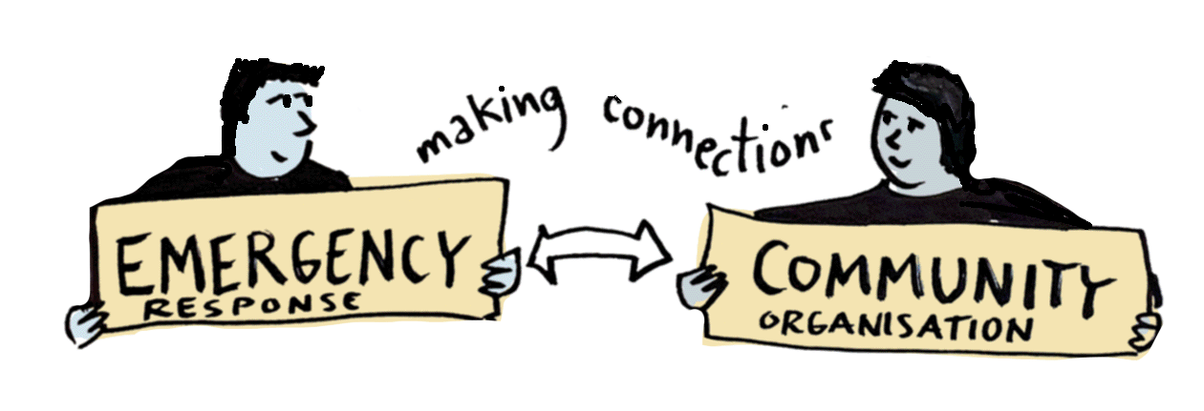
Eligibility
A registered charity based in London
Be a non-political organisation
Available on 2nd March for the workshop
Notes:
Priority will be given to organisations who haven’t participated in previous train the trainer programmes delivered by LCEP

Slide 6
Steps to apply and key deadlines
Information Session Attendance​
Application Submission​
Selection and Notification​
Workshop – 2nd March 2026
Deliver exercise and activity by May 31st 2026
Notes:
Ticked one box! attend the information session on 22nd January to learn about the programme and ask questions.​
Complete and submit the application form accurately by thedeadline of 10th February 2026 via email.​
20 spaces available; selected organisations will be notifiedpromptly after submission.​

