Slide 1
Thames Water
Priority Service Register

Slide 2

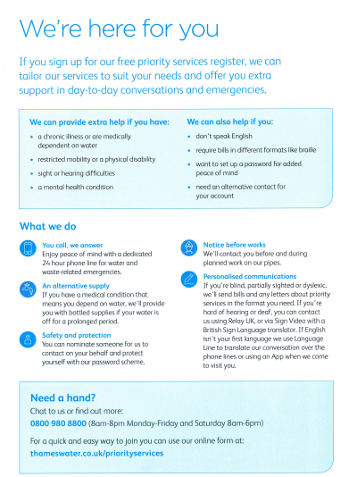

Slide 3
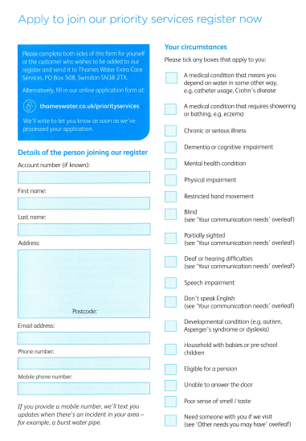
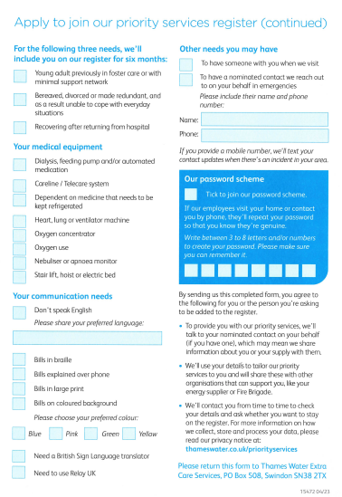

Slide 4
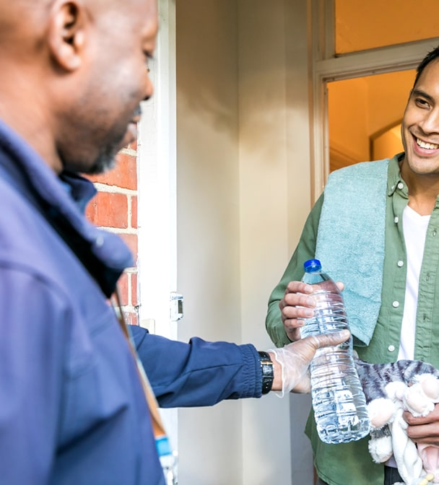
https://www.thameswater.co.uk/help/get-extra-help/priority-services
Rob Hanks
Rob.Hanks@thameswater.co.uk
Beth Reeves Beth.Reeves@thameswater.co.uk

