Slide 1
Fire and Wildfire Preparedness
London Fire Brigade

Slide 2
Introduction
London has just experienced the driest spring in more than 100 years, and is on track for a hot summer ahead.
This means there is an increased risk of wildfires affecting the capital.
Just under half of London is considered green space, but much of this lies next to homes and businesses, making it a challenging urban environment for a fire and rescue service.

Slide 3
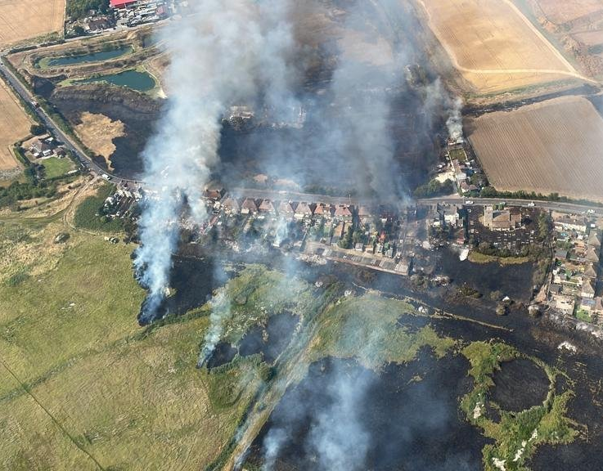
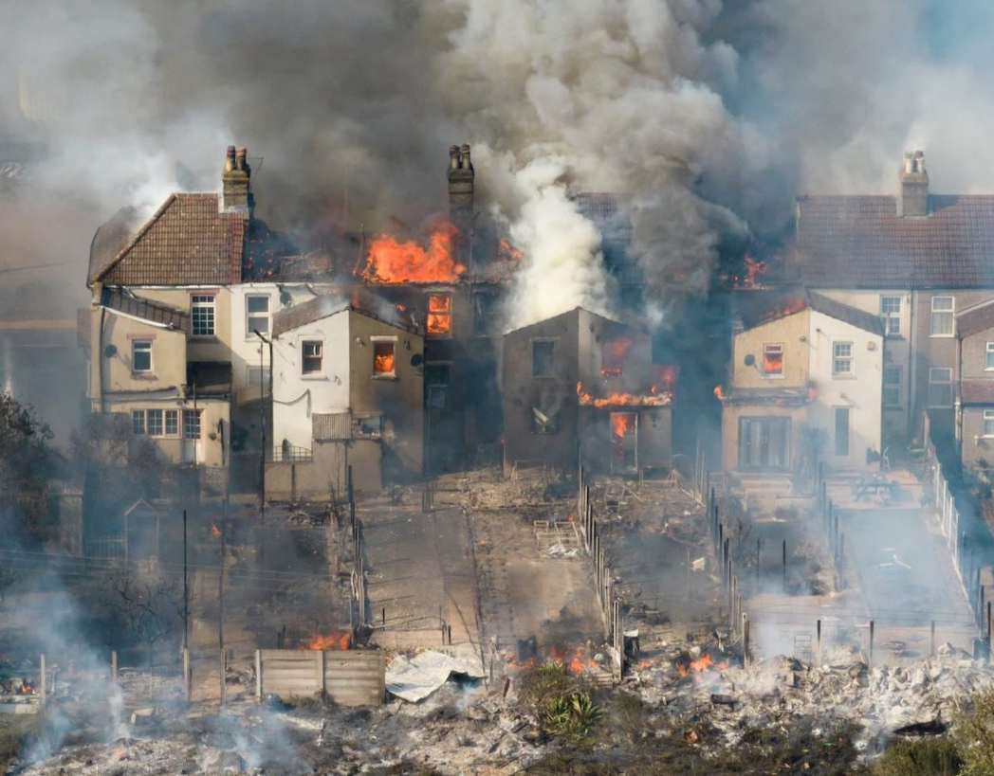
Summer 2022

Slide 4
Summer 2022
LFB faced one of its busiest days in the modern firefighting era in the summer of 2022.
Temperatures exceeded 40 degrees celsius in London for the first time since records began.
LFB was one of 11 of the 46 fire and rescue services across the UK to declare a major incident, as crews battled fires throughout the capital.
On 19 July, Control received almost 2,500 calls and crews responded to 1,146 incidents.
In Wennington, around 17 homes were destroyed by a wildfire, and across London a total of 41 homes were destroyed in a single day.

Slide 5
Operational Improvements
We are continuing a pilot this summer of deploying purpose built four-wheel-drive wildfire response vehicles. They have off-road capability and equipment that allows firefighters to pump and drive, enabling us to tackle a fire more efficiently and safely.
The wildfire vehicles will carry new equipment such as wildfire beaters and backpack blowers, which enable firefighters to push flames back into already burnt areas.
We have a specially engineered 'Holey Hose' introduced in 2023, which enables us to create a curtain of water reaching up to two metres high.
We have converted two units to carry 8,000 litres of water each, which will be invaluable at incidents where traditional water supplies are absent or ineffective, such as wildfires at the rural-urban interface.
All firefighters have received enhanced training for wildfires, and we’ve trained 30 Station and Group Commanders as Wildfire Support Officers.

Slide 6
Summer 2025 – Key Messages
Prevention is key to keeping London safe!
We are asking those responsible for maintaining green spaces to create fire breaks, especially where residential properties are nearby. This includes cutting and removing grass or ploughing earth to remove any flammable vegetation.
Homeowners can also help by maintaining their gardens and preventing them from becoming overgrown.
Avoid using disposable BBQs – this includes in parks and public spaces, in private gardens, and indoors or on balconies. They pose a significant fire risk, and heat can be retained for many hours.

Slide 7
Summer 2025 – Key Messages
Standard BBQs should never be left unattended, and should be placed away from any flammable materials (such as sheds, fences, or trees).
Discarded smoking materials pose a fire risk – ensure cigarettes are completely out, and avoid throwing them off balconies or out of car windows.
Leftover rubbish, including glass bottles, pose a fire risk in open spaces. Ensure rubbish is placed securely in a bin or take it home.

Slide 8
LFB Website
For more detailed information, all of our safety advice is available on our website:
https://www.london-fire.gov.uk/safety/grass-and-wildfires/
Or you can contact us on: community.engagement@london-fire.gov.uk

