Slide 1
Cool Spaces
Community venues and heat resilience in London – Summer 2025

Slide 2
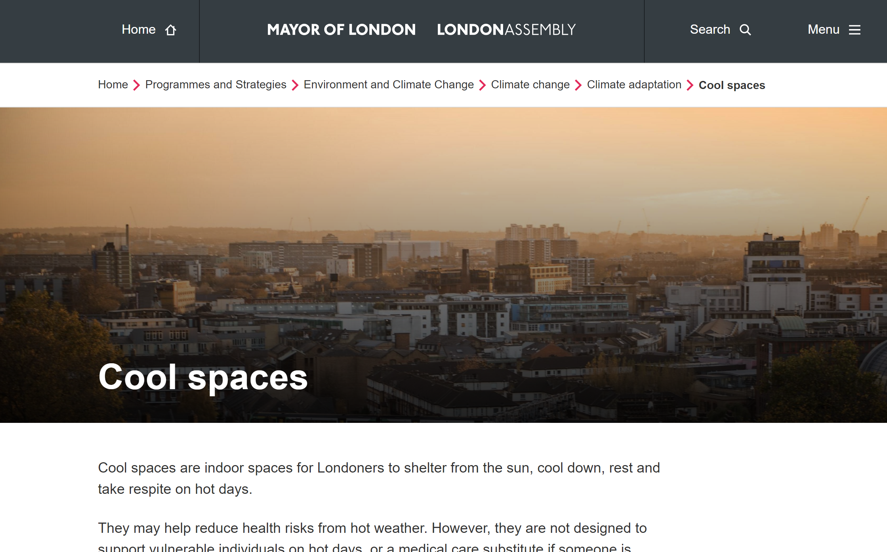
Cool Spaces
What is it?
Register of venues to help Londoners cope during hot weather.
Standards to qualify:
Free access (2 days a week minimum)
Free seating space
Free drinking water
Lower temperature than outdoors
(through shading, ventilation and/or AC)

Slide 3
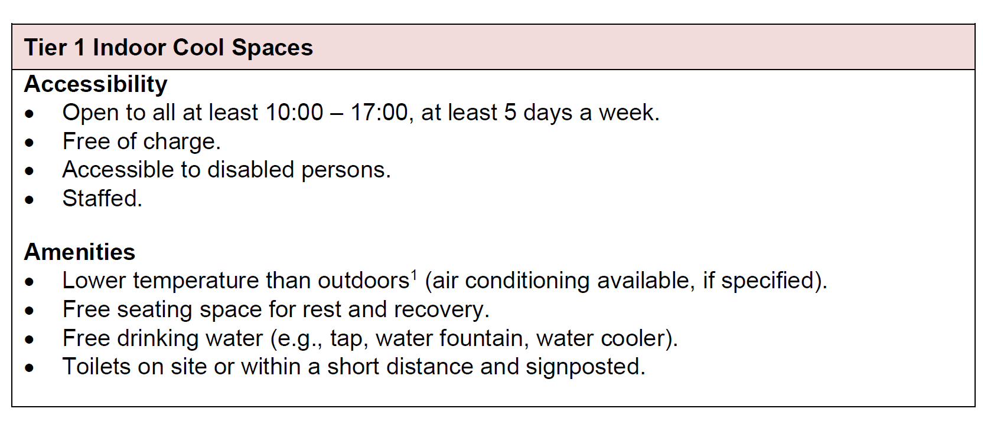
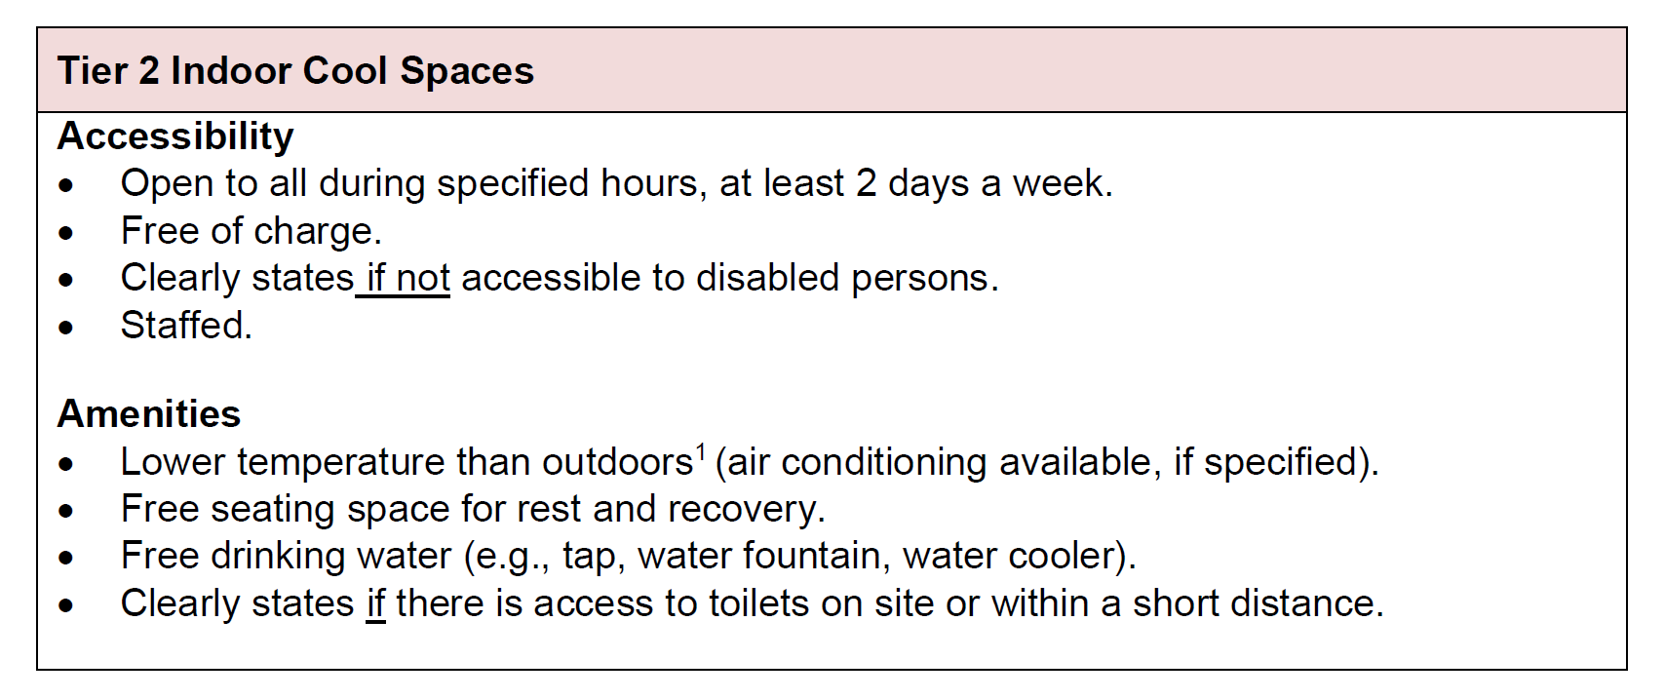
COOL Spaces
Criteria and tier system 2024
Tiers assigned to indoor spaces.
Tier 1 are open more often. Tier 2 may not have toilets or not be fully accessible.
Ancillary dataset: parks that have free drinking water, shaded seating space and toilets.

Slide 4
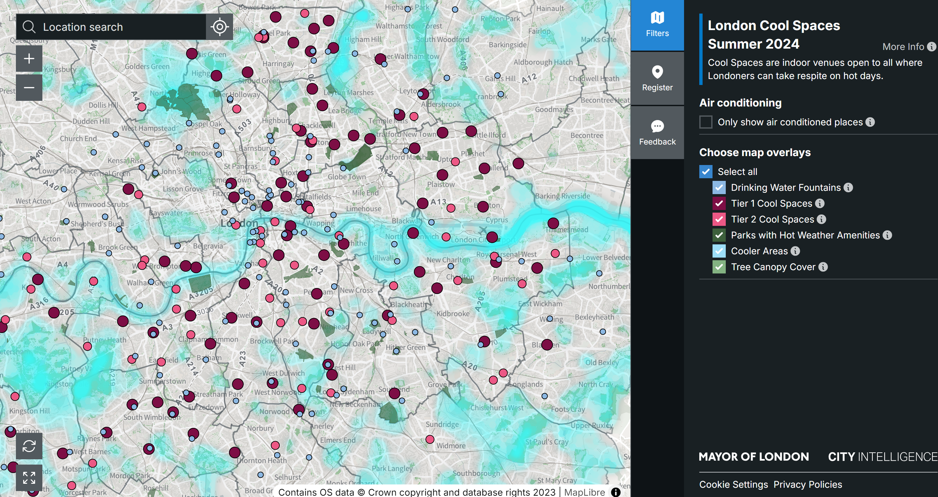
Cool Spaces
What it looks like
Customisable map:
- Filter air-conditioned spaces
- Filter by Tier
- ‘find a space’ search string
- complementary data (e.g. canopy cover)
- phone-use optimised

Slide 5
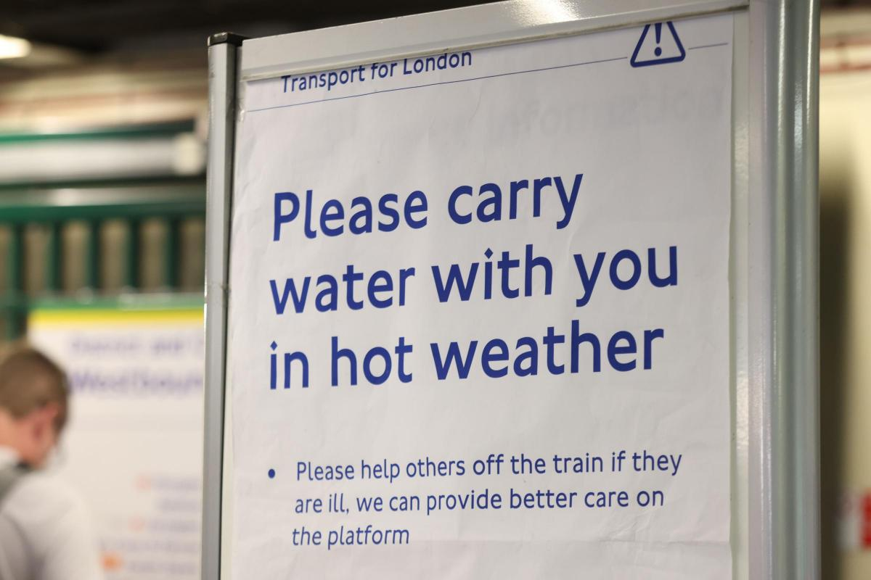
Cool Spaces
Role in the response to hot weather
Not a public health intervention for the vulnerable.
Supports amplifying heat messaging.
Supports community orgs familiarise themselves with heat health risk.
Supports boroughs climate-related work.
It empowers orgs like you!
Example of TfL messaging on a hot day

Slide 6
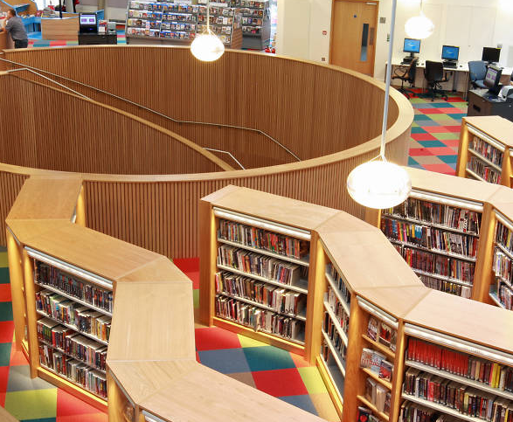
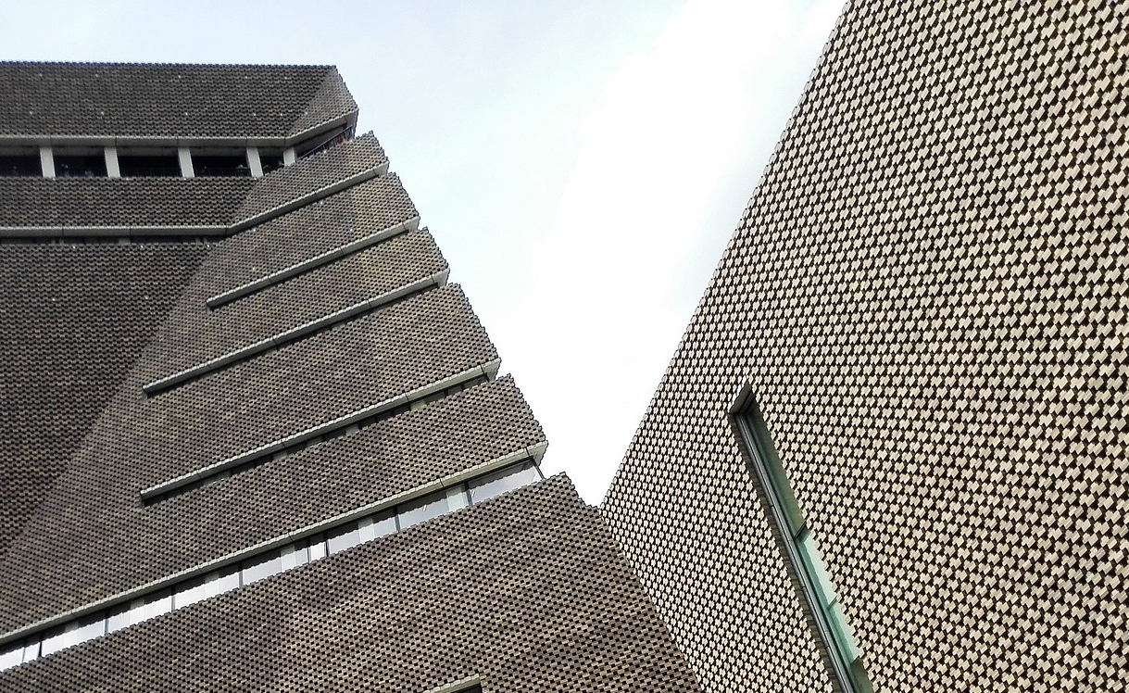
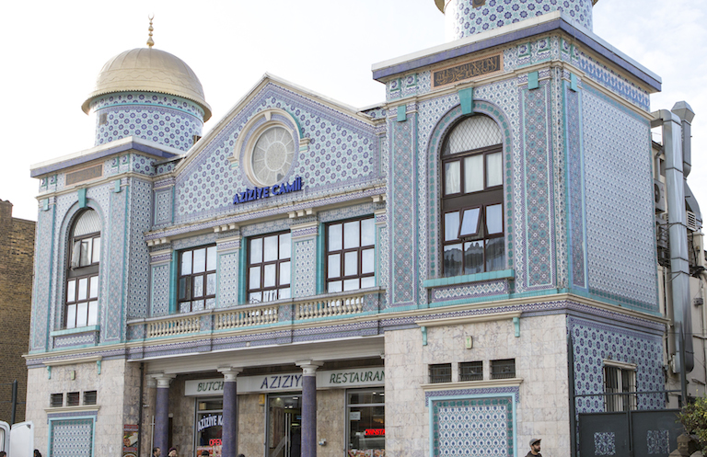
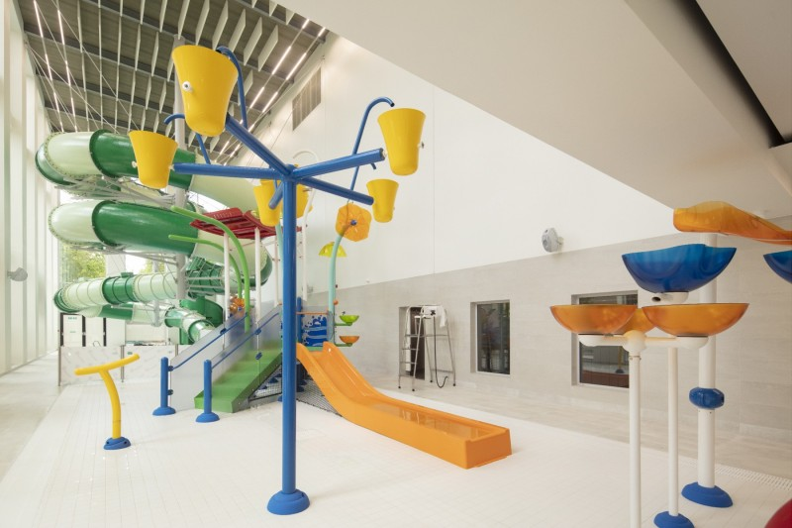
Cool Spaces
2024 – Sectors and organisations
160 Cool Spaces in 28 LBs + CoL
75 registering orgs
Breakdown:
- libraries (100)
- community spaces (26)
- faith-based spaces (18)
- culture spaces (11)
- sports venues (5)
In 2025, 148 spaces at the beginning of the season.
Registrations are open all summer.

Slide 7

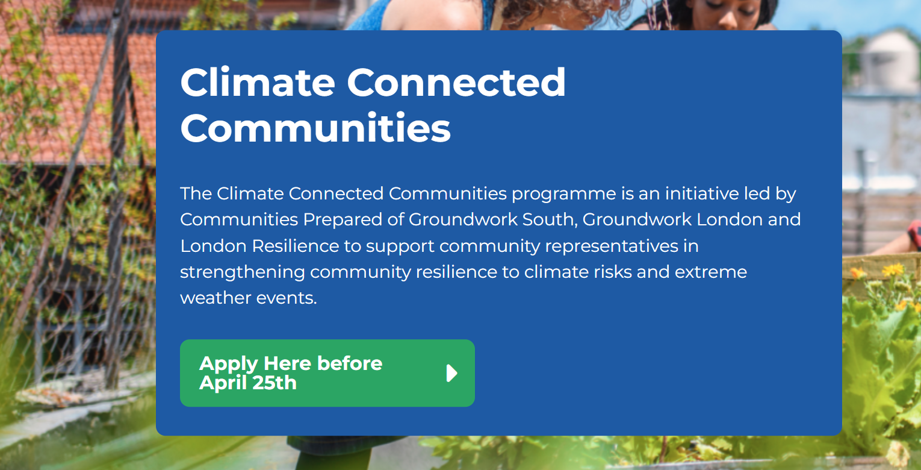
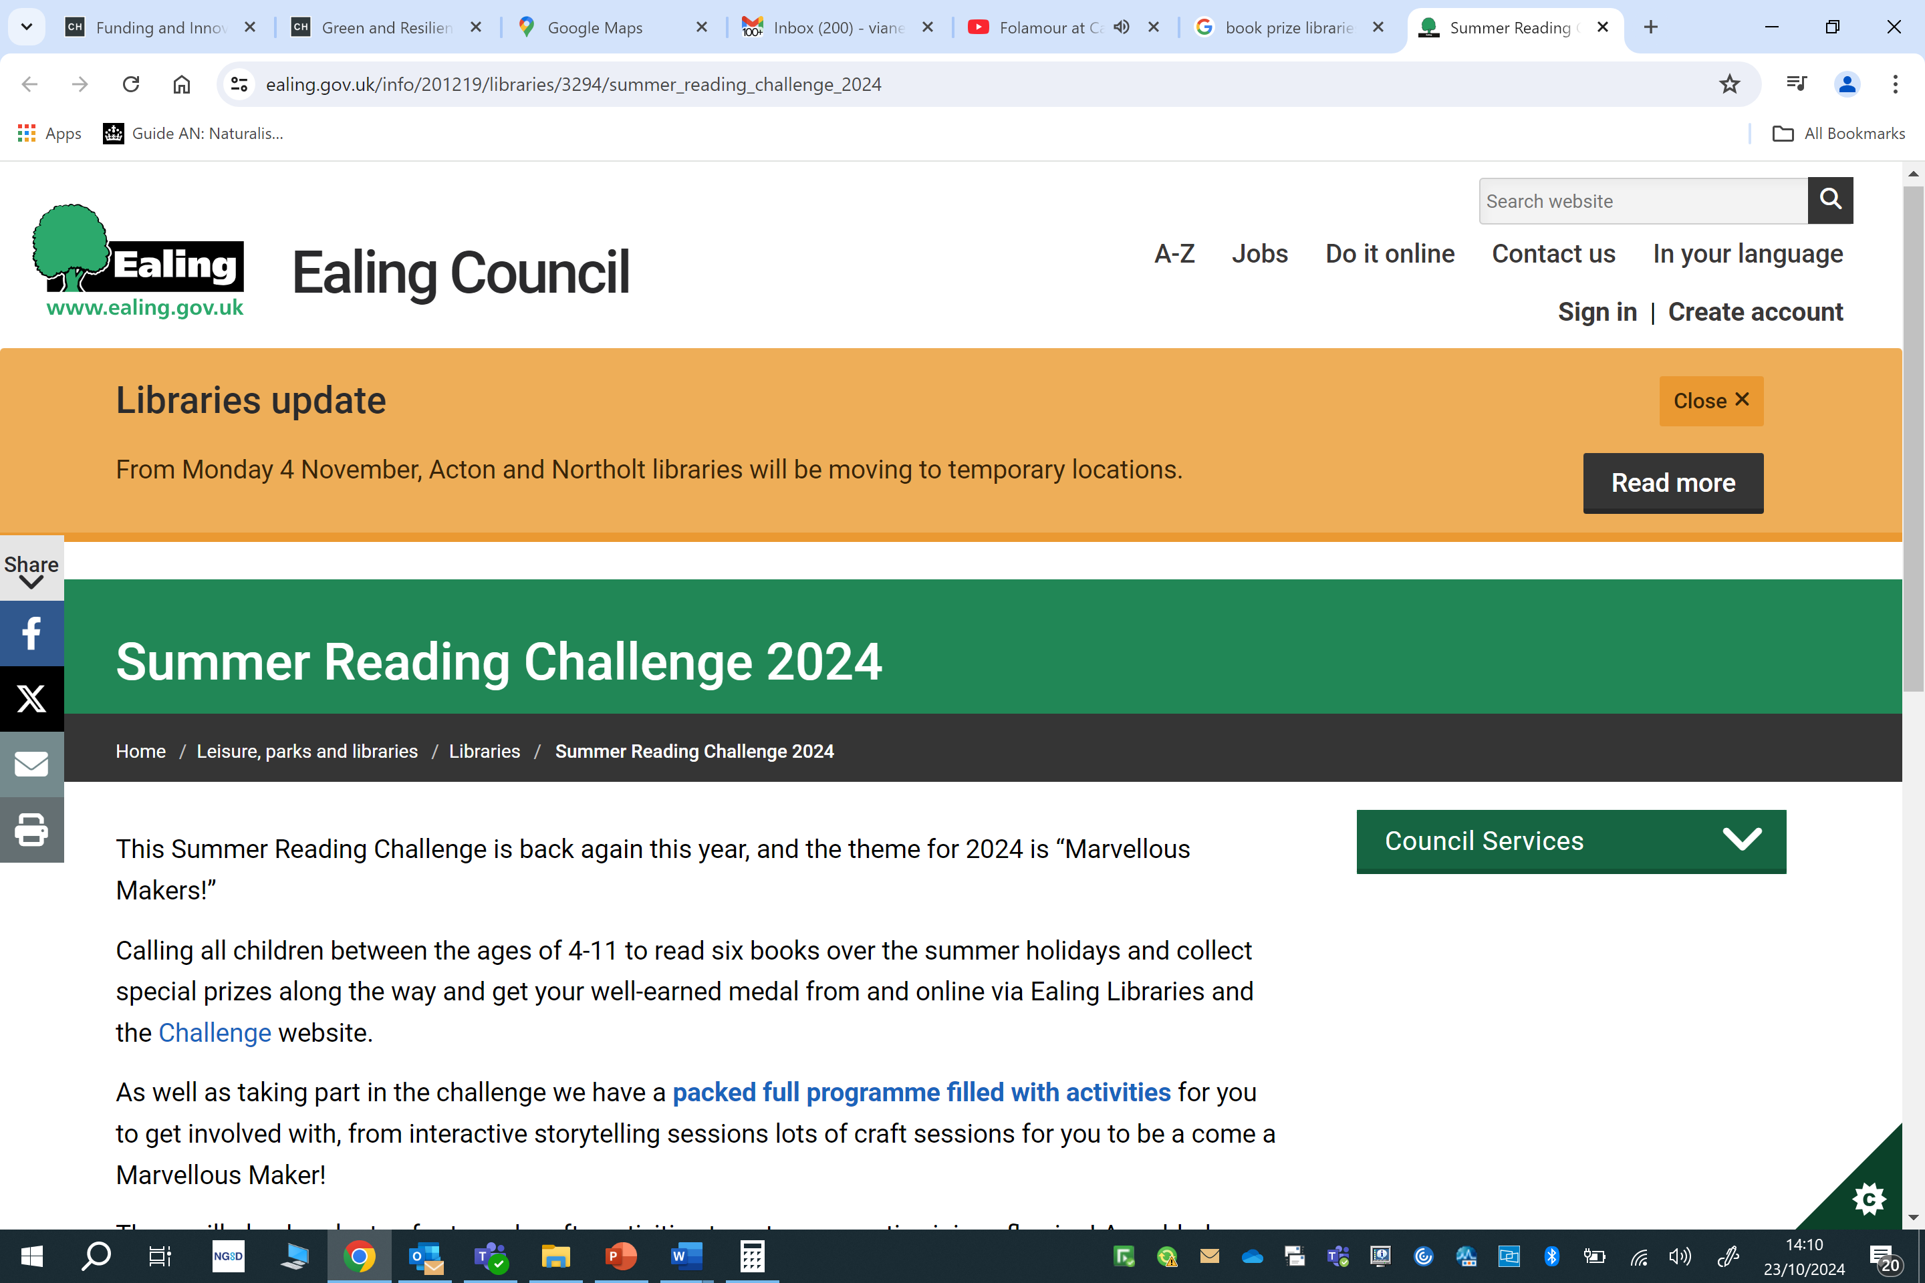
COOL Spaces
Summer 2025 – linking venues to people
Participants in our Climate Connected Communities training programme are being linked to Cool Spaces.
Pilot project with Leeds University to design comms kit on heat health risk.
We are supporting boroughs to exchange lessons and best practice.
Your borough may have summer activities in sports/culture venues.

