Slide 1
Hepatitis A & Hepatitis B Faith Network Presentation 10th June 2025 London Region Health Protection Team - Dr Sally MacVinish Patel - Consultant in Health Protection - Edward Andrews – Senior Health Protection Practitioner

Slide 2
Who are the London Health Protection Teams
There are two Health Protection Teams (HPTs) in London
- North London HPT
- South London HPT
Health Protection Teams receive notifications from GPs, hospitals and laboratories about cases of infectious disease.
We work closely with health services, local authorities and communities to arrange follow up of cases and outbreaks of the more serious infectious illnesses.
This can involve giving information and advice, arranging post-exposure vaccination or antibiotics, or requiring people to stay away from work or school.

Slide 3
What is viral hepatitis?
Hepatitis = inflammation of the liver
5 types of viral hepatitis
Hepatitis A
Hepatitis B
Hepatitis C: passed on blood to blood; many people have no symptoms, but complications can be serious; diagnosed by a blood test (free home tests in England); no vaccine, but easily treated
Hepatitis D: only caught in those with hepatitis B infection, at the same time or later; increases risk of complications of hepatitis B
Hepatitis E: rare in the UK; passed on in food and water; usually recover within months; more serious in pregnant people and those who are immunosuppressed
https://britishlivertrust.org.uk/information-and-support/liver-conditions/viralhepatitis/
Notes:
Liver disease caused by a virus
5 types of viral hepatitis passed on in different ways, with different treatments and prevention

Slide 4
What is Hepatitis A?
Sometimes called Hep A or HAV.
Usually passed on through contaminated food and water, it is mostly acquired overseas, although there has been an increase in people in the UK who have not travelled abroad.
We sometimes see spread from person to person in households or in schools and nurseries.
Only 1 in 5 adults in UK have immunity against it, either from vaccination or past infection.

Slide 5
Symptoms
Tiredness, nausea, vomiting, abdominal pain
Jaundice (70-80% of people)
Children often have milder illness or no symptoms, but still infectious.
Hospitalisation is common, around 50% of adults need hospital admission of 2 or more days
People are infectious before they feel unwell (2 weeks before) until 1 week after jaundice starts
Most people will make a full recovery without medical treatment.

Slide 6
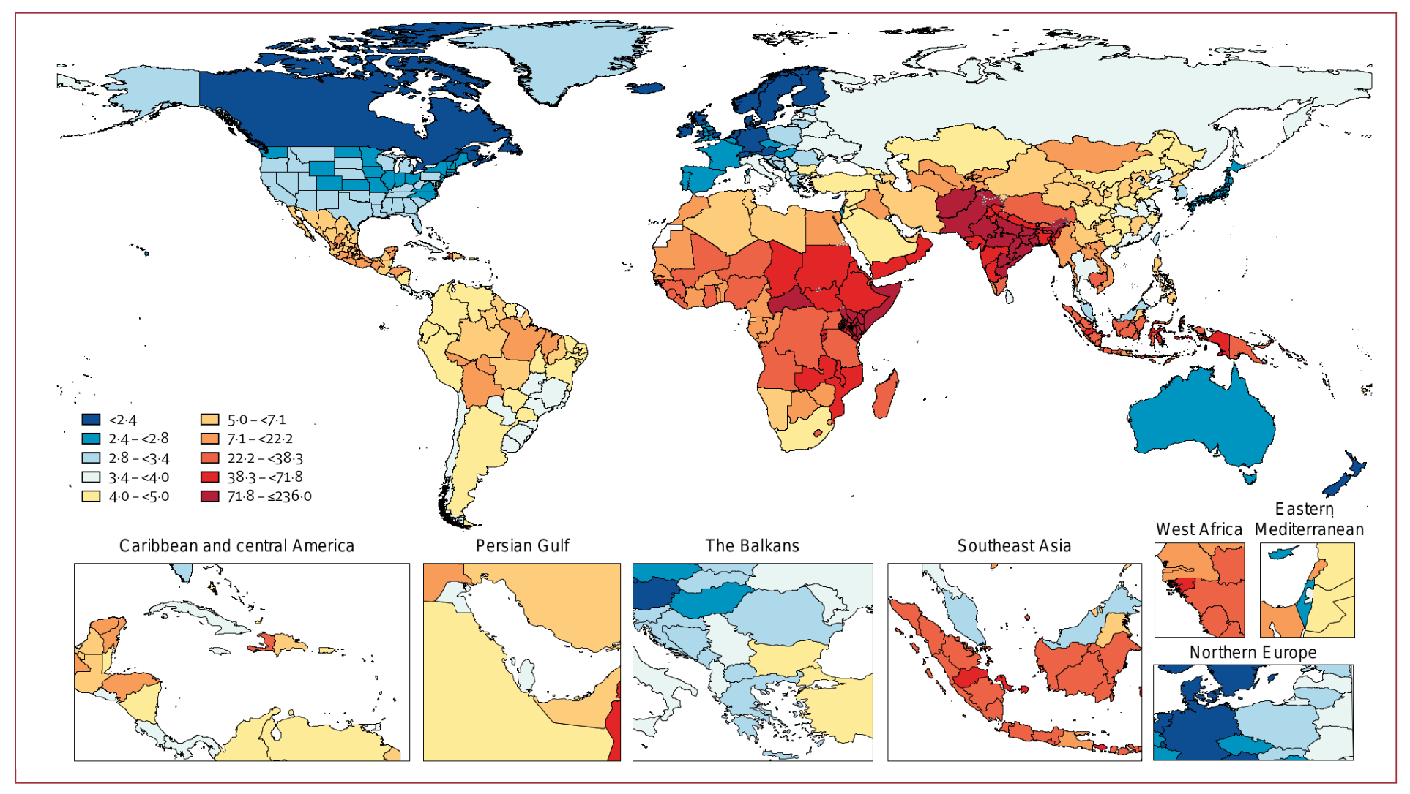
Epidemiology and recent trends
Source: Global Burden of Disease 2019 age-standardised DALY rates for hepatitis A
Notes:
Around 150 million cases of Hepatitis A every year globally.
Certain countries have Hepatitis A circulating widely, as can be seen on the map here in reds and oranges – Indian subcontinent and Central Africa.
In the UK the majority of cases we see have travelled to endemic countries. Many are people who were born in these areas and go back frequently, often without getting travel vaccines

Slide 7
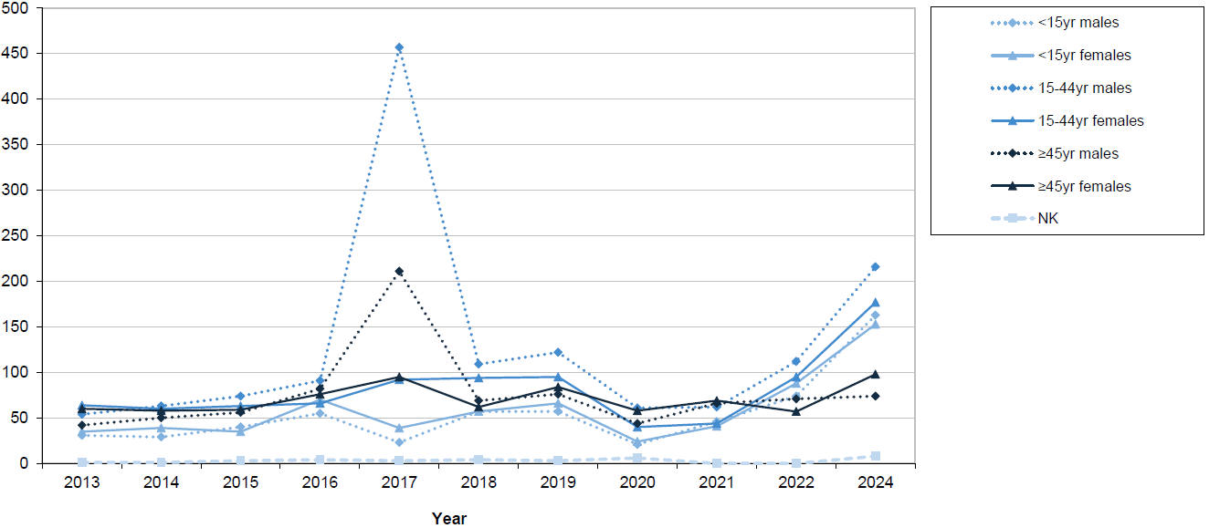
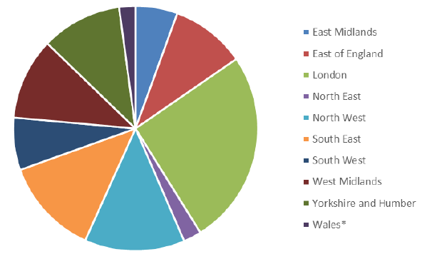
HAV reports by age groups in England, 2013 – 2024
Notes:
In the UK there are around 250-500 Hep A infections confirmed each year
There was a noticeable increase in 2024 – nearly 900 cases in England, of which over a quarter (227) were in London (See pie chart – London in light green)

Slide 8
Risk groups
There are certain people who are more likely to become severely unwell if they catch Hepatitis A:
People with chronic liver disease including Hepatitis B or C
People with immunosuppression
Some people who are HIV positive
People over 60 years old
Our work involves additional public health actions for anyone in these groups who is exposed to Hep A.

Slide 9
Vaccination and Travel advice
There is a safe and effective vaccine against Hepatitis A.
It is not part of routine immunisations, but is offered as a travel vaccine.
Particularly important for those who were born in, or their family is from regions where Hep A is common.
The vaccine is free on the NHS and many (but not all) GP practices offer it as a travel vaccine. It is also available from private travel clinics, but these will charge for it.
Best to get vaccines 6-8 weeks before travel, but it's still worth having a travel health appointment at any point before departure. Check what other travel vaccines are needed, e.g. Typhoid fever.

Slide 10
Hygiene (D&V 48 hour rule)
For anyone with diarrhoea and vomiting they should not attend work or school until at least 2 days have passed AFTER their symptoms have stopped.
There are some infections where people should stay away from work longer if they have certain jobs e.g. working with food, or looking after young children or vulnerable people. Health Protection Teams will contact them directly to give that advice.
For any infections involving diarrhoea and/or vomiting, the most important thing is keeping good hygiene; particularly hand hygiene after using the bathroom and before eating or preparing food. Unless unavoidable, don't cook for others when ill.
When travelling abroad, remember to always follow food and water hygiene guidance.
Notes:
As there are similarities how Hep A is spread and other food poisoning illnesses, so this is slide has some general advice.

Slide 11
Hepatitis B overview
Affects millions of people around the world
Passed on by blood-to-blood contact
Mother to child transmission is the main way infection is passed on globally, this is less common in the UK
Acute hepatitis B = when first infected, flu-like or no symptoms
Chronic hepatitis B = if the infection is not cleared in 6 months.
Infections can be lifelong: inflammation -> scarring (cirrhosis) -> liver failure/ cancer
Very effective vaccine
Currently no treatment cure, but there is treatment to control it
https://britishlivertrust.org.uk/information-and-support/liver-conditions/viralhepatitis/

Slide 12
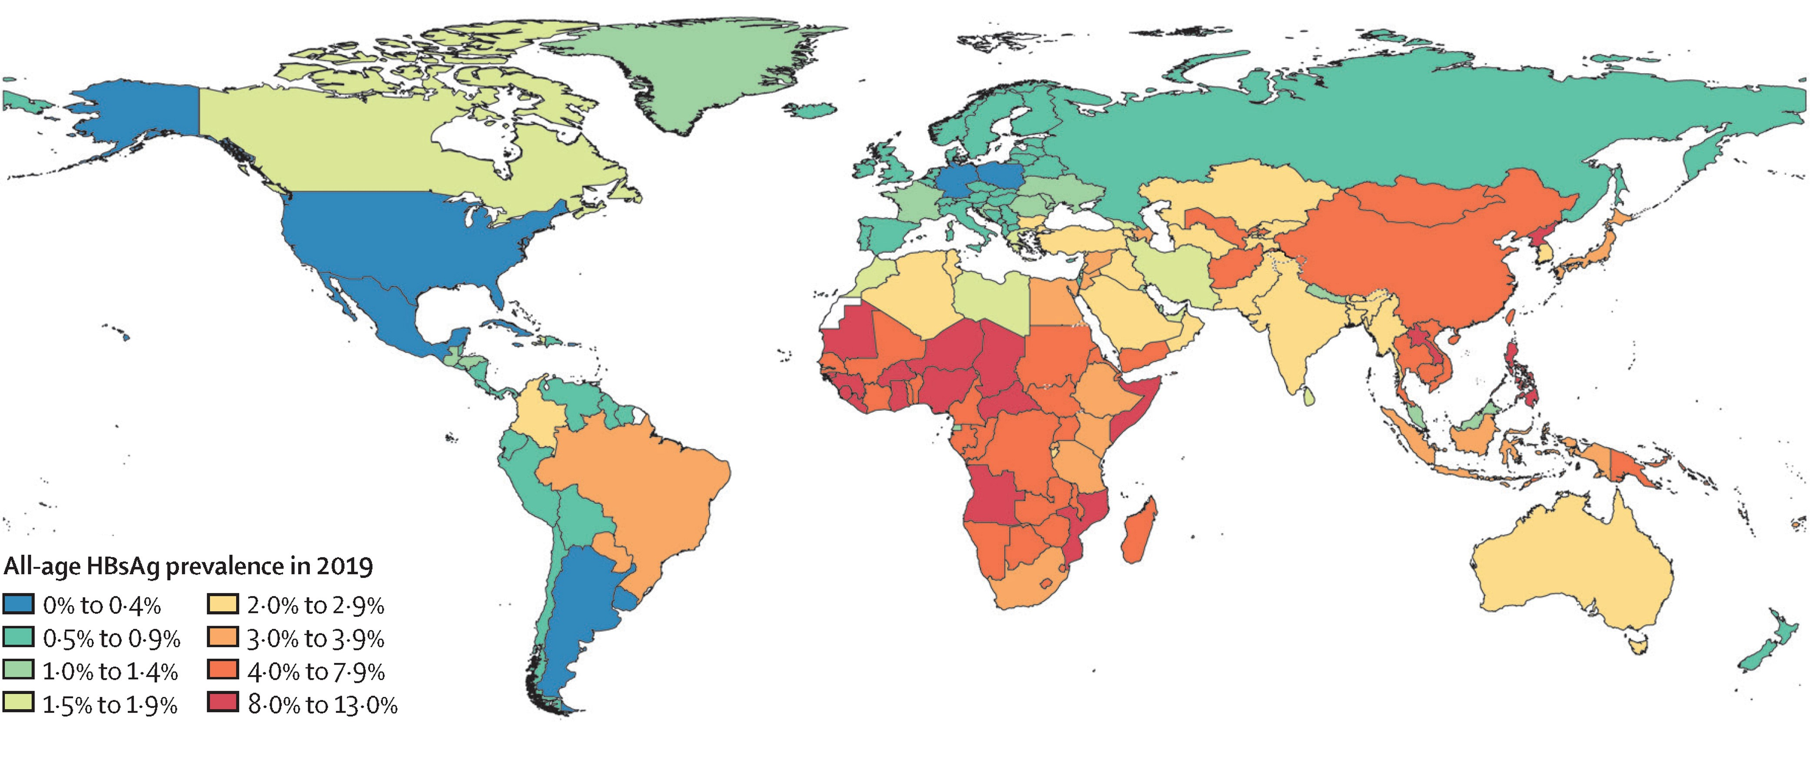
Hepatitis global patterns
Global, regional, and national burden of hepatitis B, 1990–2019: a systematic analysis for the Global Burden of Disease Study 2019. Sheena, Brittney S et al. The Lancet Gastroenterology & Hepatology, Volume 7, Issue 9, 796 - 829
Notes:
This map shows how the rates of hepatitis B infection are distributed globally. The areas in the “warmer” colours have higher rates of hepatitis B infection with red being the highest, and blue being the lowest. You can see Africa and Asia are most affected by hepatitis B infection.

Slide 13
Testing for hepatitis B
Get tested so you can get treated quicker.
Consider testing if
You have symptoms of hepatitis B
You think you may have been exposed to the virus – if you are from a country where hepatitis B is more common
You are pregnant – this test is offered routinely to all pregnant women in the UK
We will be informed in the health protection team and if an infection is recent, we will call to guide on the next steps
Test results will not affect chances of seeking asylum or immigration cases
https://britishlivertrust.org.uk/information-and-support/liver-conditions/hepatitis-b/hepatitis-b-tests/
Notes:
Detecting hepatitis B early means it can be treated quicker and reduces the chance of serious complications
In some A&Es you will be offered the test regardless of what you have attended for
Otherwise tests can be done for free at GPs or sexual health clinics

Slide 14
Vaccines against hepatitis B in the UK
Babies
Since 2017 in routine childhood immunisations
Born to mums with hepatitis B infection – includes extra vaccination, tests and sometimes treatment too
People at higher risk of getting hepatitis B infection
Close contacts of someone with hepatitis B
Those who might get very ill with hepatitis B
Those who’s jobs put them at higher risk
Travel (although you may have to pay for this)
People who have just been exposed to hepatitis B infection
Vaccines against hepatitis B work very well and are safe. They stop children and adults getting hepatitis B.
https://britishlivertrust.org.uk/information-and-support/liver-conditions/hepatitis-b/vaccine/
Notes:
Vaccines against hepatitis B work very well and are safe. Getting vaccinated stops children and adults from getting hepatitis B.

Slide 15
Living with Hepatitis B
Hepatitis B is one of the commonest viral infections globally, you are not alone.
However got the hepatitis B infection, it is not their fault. It is mainly picked up at birth or in childhood.
People living with hepatitis B can have children and a normal family life; vaccination stops the virus being passed on
People living with hepatitis B can enjoy meals with friends and hug loved ones – the virus can’t be passed on these ways
Hepatitis B can be treated and controlled
https://britishlivertrust.org.uk/information-and-support/liver-conditions/hepatitis-b/myths/

Slide 16
Measles
There was a large measles outbreak in England in 2024, with most cases in London. Cases decreased at the end of the year, but as of April 2025 have started rising again, particularly in East London.
It is a highly infectious virus that typically affects children and younger adults, 20-40% of people will be hospitalised. Complications can include deafness, blindness and in rare cases death.
There is a safe and effective vaccine against measles called the MMR, it also offers protection against Mumps and Rubella.
MMR is offered by GP practices, there is no upper age limit to receive it, and if people are unsure if they have had the recommended 2 doses, there is no harm caused by having an additional vaccine.

Slide 17
Links
Visiting friends and relatives abroad: advice for travellers
https://www.gov.uk/government/publications/travelling-overseas-to-visit-friends-and-relatives-health-advice/visiting-friends-and-relatives-abroad-advice-for-travellers
General advice for travellers
https://travelhealthpro.org.uk/factsheet/30/general-advice-for-travellers
NHS Hepatitis A
https://www.nhs.uk/conditions/hepatitis-a/
NHS Measles
https://www.nhs.uk/conditions/measles/
NHS MMR
https://www.nhs.uk/vaccinations/mmr-vaccine/
British Liver Trust
https://britishlivertrust.org.uk/information-and-support/liver-conditions/viralhepatitis/

