Slide 1
Social Prescribing for Children and Young People in London
Suzi Griffiths
Project Manager and NHS Social Prescribing Regional Facilitator London
Healthy London Partnership
suzi.griffiths@nhs.net

Slide 2
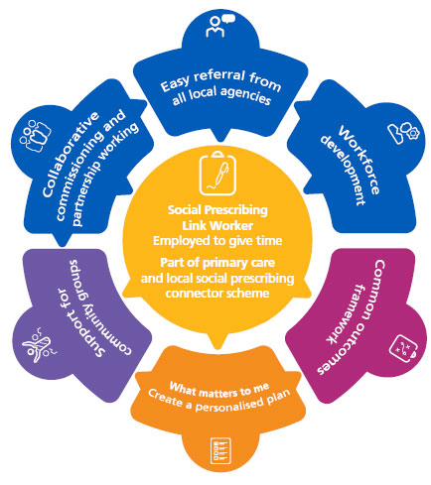
Social Prescribing – what is it?
Social Prescribing (SP) is the process by which health professionals refer patients to Social Prescribing Link Workers (SPLW) to address their non-clinical needs that are negatively impacting on their health and wellbeing.
SPLW connect people with community based organisations, servces and activities to prevent the exacerbation of current issues and conditions, and ultimately help tackle health inequalities.
SP should be about what matters to me – friendship and society, creativity, physical activity, being outdoors, conversation, consolation, laughter, safety.
SPLW are there to listen and get people the help and support they need for issues such as finance, housing, employment, social welfare and legal advice.
SP is intended to support but not replace formal healthcare resources such as psychiatric support and medical treatment.
Source: NHS England https://www.england.nhs.uk/personalisedcare/social-prescribing/

Slide 3
Social Prescribing in London
Social Prescribing (SP) is being mainstreamed by NHS England with Social Prescribing Link Workers (SPLW) based in Primary Care Networks (PCNs) since June 2019. In London, there are Social Prescribing services based in all boroughs and more than 350 SPLW covering c200 PCNs.
The majority of SP services are for adults only when Personalised Care should deliver ‘whole population approaches to supporting people of all ages’ (NHSE, Universal Personalised Care Model). There is a gap for babies children and young people that needs to be addressed more now than ever, recognising that 40% of activity in primary care relates to them.
PCNs use the Additional Roles Reimbursement Scheme (ARRS) to recruit Social Prescribing Link Workers and other Personalised Care roles into GP practices. A very small number of PCNs in London are using the ARRS funding to employ CYP SPLW.

Slide 4
CYP SP - Current landscape in London
Early intelligence gathering in London has revealed activity/interest:
North East London initiated a series of 6-month test pilots in 2021 in 6 boroughs to develop local models of CYP SP;
Waltham Forest Early Years SP project; City and Hackney; Redbridge and Newham
SP projects live in Enfield & Islington; Camden, Haringey and Barnet ICS funded projects in 22/23
West London looking to recruit CYP SPLW in 3 PCNs Greenwich, Lambeth (Herne Hill Practice and Well Centre) and Bexley
1 CYP SPLW in Wandsworth; Merton to commission a pilot
Part of wider NHS London plans for CYP Integration and the Improvement Collaborative
Conversations about opportunities for CYP SP in secondary care / MH Trusts:
Kings Adolescent Outreach Service (KAOS) partnership with Redthread
Imperial College Healthcare NHS Trust – recruiting Paediatric Coordinator with SP remit
Barts Health Trust – recruiting a CYP SPLW
East London NHS Foundation Trust
Lewisham and Greenwich NHS Trust
Social Prescribing for CYP at risk of youth violence, led by the NHS London Violence Reduction Programme:
Development of a pathway and toolkit - https://www.england.nhs.uk/london/london-clinical-networks/our-networks/violence-reduction/social-prescribing/
Pilots in Enfield and Hackney

Slide 5
Social Prescribing – opportunities for CYP
Social Prescribing for CYP is an emerging area nationally and there is growing energy and commitment to develop approaches in London.
Social Prescribing for CYP can be all age (0 up to 18/25 years) and/or can be targeted at particular cohorts for specific reasons:
Long term conditions such as asthma, diabetes
Mental Health e.g waiting CAHMS assessment, social isolation, low level anxiety and depression
At risk of youth violence
Learning disabilities and autism e.g waiting autism assessment
Families with young children aged 0-5 years
Transition points (e.g. children to adults services, primary to secondary school, step down from statutory services)

Slide 6
Developing ambitions for CYP Social Prescribing in London
On Wednesday 6th October 2021, the NHSE London CYP Strategic Forum agreed to support the expansion of Social Prescribing for CYP in London. It was agreed to:
Pilot different CYP SP approaches and pathways, in every Integrated Care System (ICS) region in London, for example, in different settings, different target cohorts etc to test models and identify best practice.
NHS London Transformation Funding identified to support activity at ICS level, in collaboration with borough integrated care partnerships.
On Wednesday 20th October, a Strategic Roundtable to develop a common shared ambition for CYP Social Prescribing in London.
Approx 40 attendees from multi-agency strategic partners including NHS, ICS’, local authorities, London Sport, Partnership for Young London, London Plus.
Agreement to have CYP Social Prescribing activity in every borough by 2023/24.

Slide 7
Social Prescribing for CYP requires a different approach – Widely recognised that CYP don’t access primary care in the same way as adults. Need to consider local infrastructure and population health needs.
Know what is already out there! – A great and diverse range of activities and services for CYP and families is available in communities provided by local authorities, schools, children’s centres, charities, youth organisations, libraries and leisure centres. Much of the work they do already is Social Prescribing (but not necessarily called that!).
A multi-agency approach is required – NHS needs to collaborate with local authorities, schools and youth VCSE sector to ‘join the dots’ about what services and activities are available locally to avoid duplication and build workable pathways.
Social prescribing is the bridge between health and care settings and the community.
It is a mechanism for connecting all the different agencies that support the physical, mental and emotional health and wellbeing of CYP.
Social Prescribing supports early intervention, and in preventing problems from reaching the point when clinical interventions may be necessary.

Slide 8
Sources of further information on CYP SP
Street Games & National Social Prescribing Youth Network - https://network.streetgames.org/resources/young-peoples-social-prescribing-resources
Wales Youth Social Prescribing, Sport and Physical Activity – A rapid review (March 2021) https://www.streetgames.org/Handlers/Download.ashx?IDMF=f85d4cf2-6d10-4482-a89a-ccad37cbd679
UCL (2020) ‘Social Prescribing for children and young people: A review of the evidence’ https://www.ucl.ac.uk/evidence-based-practice-unit/sites/evidence-based-practice-unit/files/review_social_prescribing_in_children_and_young_people_final_0.pdf
University of East London (2020) ‘A two year evaluation of the Young People Social Prescribing pilot’ - https://repository.uel.ac.uk/item/88x15
For further information about Social Prescribing in London please contact the Healthy London Partnership team at: hlp.socialprescribing@nhs.net or @SP_LDN on Twitter.

