Slide 1
DELIVERING FACE-TO-FACE SERVICES DURING LOCKDOWN
Hilary Nightingale
Cardinal Hume Centre
www.cardinalhumecentre.org.uk

Slide 2
CARDINAL HUME CENTRE
Working in Victoria for over 30 years to help families and young people overcome the threat of poverty and homelessness

Slide 3
FACE TO FACE WORK IN LOCKDOWN
What was the impetus for us trying to deliver face to face work?
What are the challenges?
How is it working and what are the benefits?
What have we learnt?
Next steps …
Notes:
This is the critical thing we are trying to achieve. Improved impact by intervening more early. We know difficult and inttractable problems find their roots in the family and at a young age. We believe by improving our action and doing this at an ealrier stage we can improve our impact and the lives of more people. We amplify the value of what we do and what others give.
Patrick mentioned, be clear on the reason, this is the primary reason for the change.

Slide 4
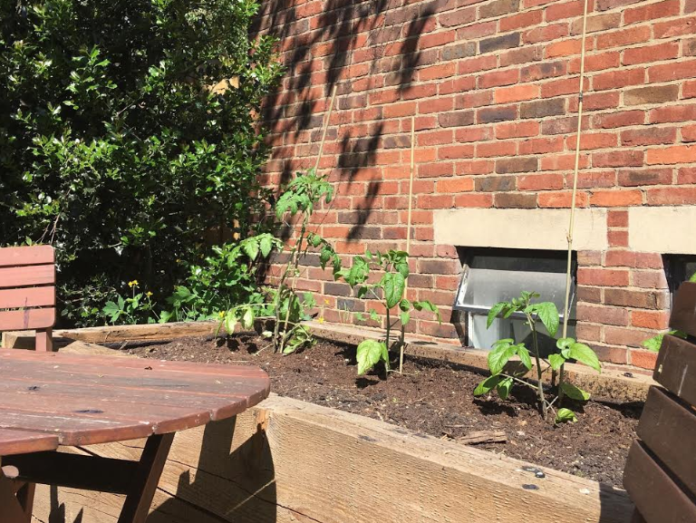
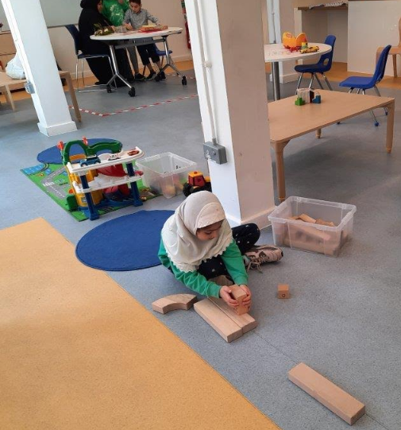

Slide 5
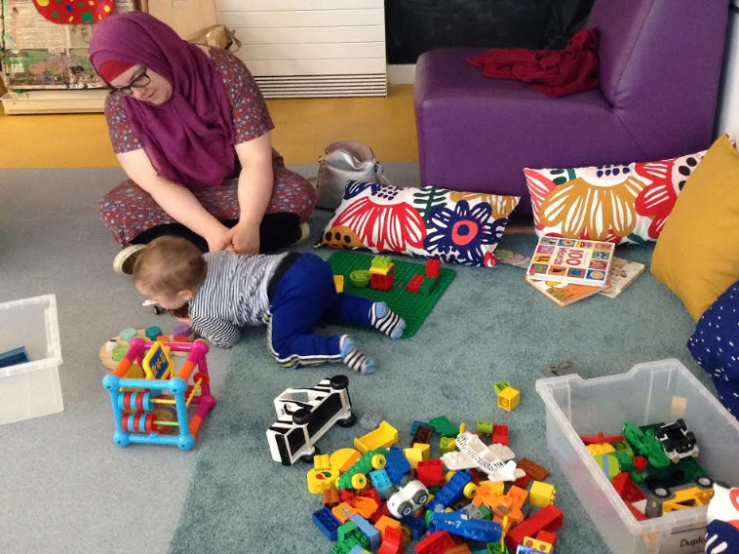
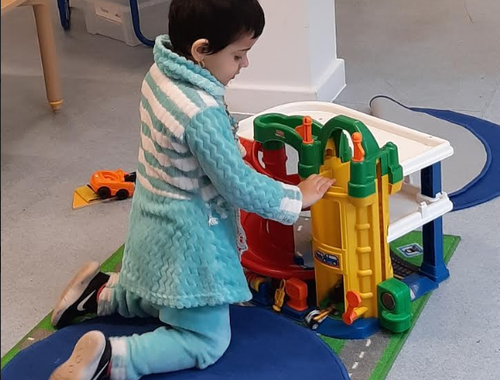

Slide 6
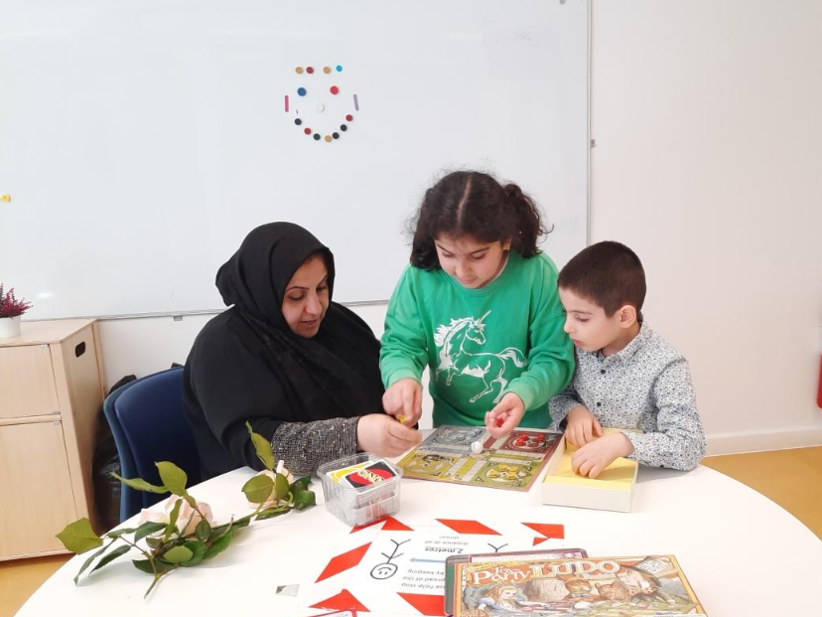
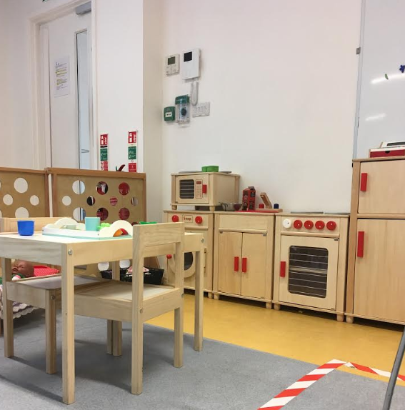

Slide 7
Face-to-face work during lockdown: what have we learnt?
Don’t rush into doing new things; take time to think through how to make it work.
Before making decisions, have lots of conversations - with clients, other agencies and partners, and staff
Making time for 1 to 1 conversations with parents is very valuable
Don’t make assumptions – about anything – especially the issues being faced by families
Emerging needs: - Access to digital skills and technology - Advice – debt, benefits and housing - Relationship and domestic abuse support

Slide 8
DELIVERING FACE-TO-FACE SERVICES DURING LOCKDOWN
Hilary Nightingale
Cardinal Hume Centre
www.cardinalhumecentre.org.uk

